Slide 1
Benchmarking Graph Attention Networks
Kamalesh Neerasa
Shreyansh Nagori

Slide 2
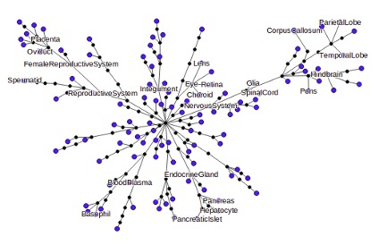
PPI
It is a human protein-protein interaction (PPI) network, tissue-specific network layers, tissue hierarchy, and tissue-specific gene-function relationships. They took the latest protein, tissue, and function information from various reputable public data sources.
For example, they represented similarities between tissues with a hierarchy defined over 219 tissues (e.g., muscle, adrenal cortex, bone marrow), pictured here. We then constructed a multi-layer network with 107 layers, each representing one tissue-specific protein interaction network, shown as a blue leaf in this picture.

Slide 3
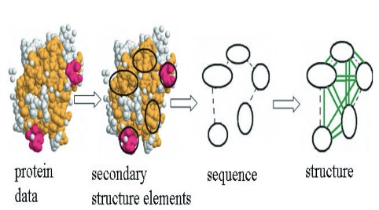
PROTEIN FULL
Computational approaches to protein function prediction infer protein function by finding proteins with similar sequence, structure, surface clefts, chemical properties,amino acid motifs, interaction partners or phylogenetic pro-files. We present a new approach that combines sequential,structural and chemical information into one graph model of proteins. We predict functional class membership of enzymes and non-enzymes using graph kernels and support vector machine classification on these protein graphs.

Slide 4
BRIGHTKITE
Brightkite was once a location-based social networking service provider where users shared their locations by checking-in. The friendship network was collected using their public API, and consists of 58,228 nodes and 214,078 edges. The network is originally directed but we have constructed a network with undirected edges when there is a friendship in both ways. We have also collected a total of 4,491,143 check ins of these users over the period of Apr. 2008 - Oct. 2010

Slide 5
PREDICTION TASKS
⚫Pairwise node classification -
Given two nodes, predict if they belong to the same class
⚫Link Prediction -
To predict if there is an edge between two nodes
⚫Multi-class node classification -
To predict the class labels for a given node

Slide 6
DATASET DETAILS
Summary of Datasets used in our experiments
 | Protein | PPI | BrightKite
Nodes | 43471 | 56944 | 58228
Edges | 162088 | 818716 | 214078
Classes | 3 | 121 | -
Features | 29 | 50 | -
Tasks | 1 | 2 and 3 | 2

Slide 7
EVALUATION METRICS
⚫ROC AUC - It tells how much model is capable of distinguishing between classes
⚫Precision- It is the ratio TP / (TP + FP)
⚫Recall - It is the ratio TP / (TP + FN)
⚫F1 score -It is the harmonic mean of Precision and Recall

Slide 8
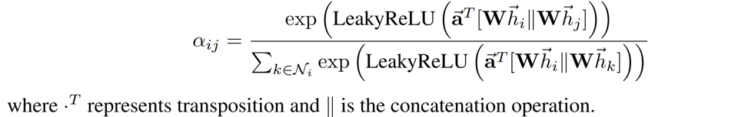
GRAPH Attention Networks(GAT)
Generate node embeddings based on weighted local neighbourhood. The weights are learnt during back-propagation.

Slide 9
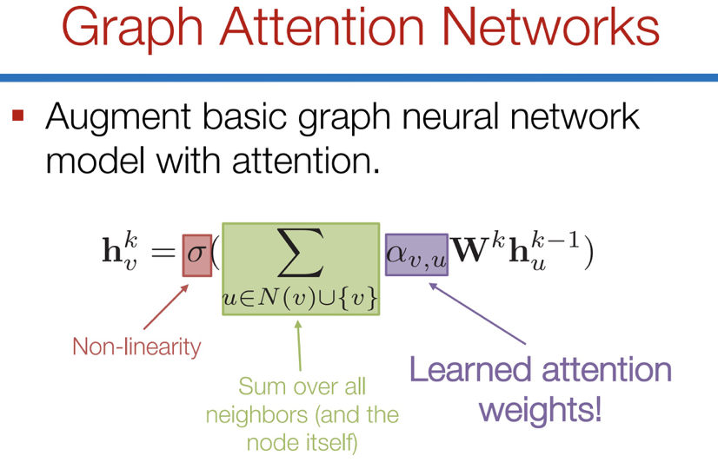
Graph Attention Networks (GAT)

Slide 10
PPI Node Classification
Node embedding architecture
Trains model to generate an embedding for each node from features of size class label which is passed through sigmoid activation function to use as predictions.
Inductive Setting
PPI consists of 24 graphs and we used K fold CV for training
Binary Cross Entropy Loss, Early Stopping, Skip Connections
Adam Optimizer with a scheduler which decays learning rate by a factor of 10 if the val loss or F1 does not change for last 10 epochs

Slide 11
PPI Multi-Class Node Classification
Fold Number | Valid ROC-AUC Score | Valid F1 Score | Test ROC-AUC Score | Test F1 Score
1 | 0.9805 | 0.9389 | 0.9809 | 0.9393
2 | 0.9412 | 0.8840 | 0.9514 | 0.8949
3 | 0.9603 | 0.9354 | 0.9738 | 0.9320
4 | 0.9801 | 0.9399 | 0.9796 | 0.9354
5 | 0.9051 | 0.8502 | 0.9683 | 0.9242
Cumulative | 0.9537 | 0.909 | 0.9708 | 0.9251

Slide 12
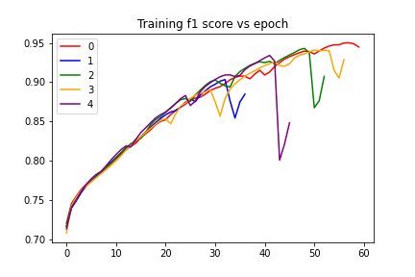
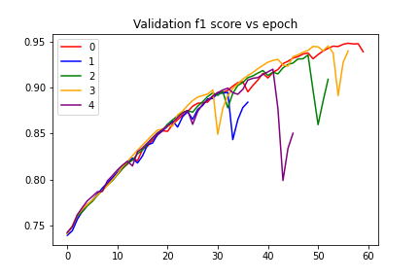
Training and validation F1 scores vs epochs

Slide 13
PPI Link Prediction
Encoder Decoder architecture
Use 50% of edges in the graph to compute embeddings of nodes and use the rest of the 50% for train/test dataset
Inductive Setting
PPI consists of 24 graphs and we used K fold CV for training
Generate a new negative sample of edges(edges different from the original graph edges) during each epoch using Pytorch negative_sampling function. The number of negative samples is same as number of positive samples
Binary Cross Entropy Loss, Early Stopping, Skip Connections
Adam Optimizer with a scheduler which decays learning rate by a factor of 10 if the val loss or F1 does not change for last 10 epochs
Decoder: Neural network with two hidden layers with sigmoid activation in the final layer.

Slide 14
PPI Link Prediction
Fold Number | Valid ROC-AUC Score | Valid F1 Score | Test ROC-AUC Score | Test F1 Score
1 | 0.9058 | 0.8274 | 0.9047 | 0.8254
2 | 0.9014 | 0.8222 | 0.8959 | 0.8158
3 | 0.9018 | 0.8219 | 0.9018 | 0.8219
4 | 0.8991 | 0.8204 | 0.9000 | 0.8196
5 | 0.9019 | 0.8234 | 0.9065 | 0.8271
Cumulative | 0.902 | 0.8238 | 0.9017 | 0.8219

Slide 15
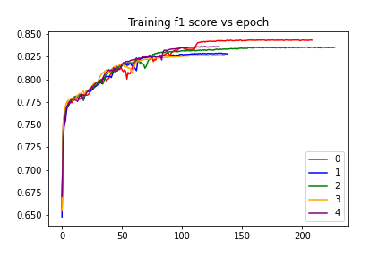
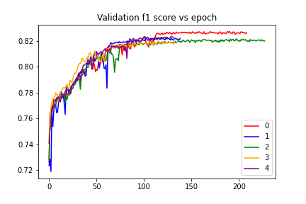
Training and validation F1 scores vs epochs

Slide 16
Pairwise Node classification for protein dataset
Encoder Decoder architecture
Use pairs of nodes in the graph having same labels as positive samples and pairs of nodes with different classes as negative samples.
Inductive Setting
Consists of 739 graphs and we used K fold CV for training
Binary Cross Entropy Loss, Early Stopping, Skip Connections
Adam Optimizer with a scheduler which decays learning rate by a factor of 10 if the val loss or F1 does not change for last 10 epochs
Decoder: Neural network with two hidden layers with sigmoid activation in the final layer.

Slide 17
Pairwise Node classification for protein dataset
Fold Number | Valid ROC-AUC Score | Valid F1 Score | Test ROC-AUC Score | Test F1 Score
1 | 0.8632 | 0.8202 | 0.8210 | 0.7268
2 | 0.9407 | 0.8690 | 0.9475 | 0.8807
3 | 0.8632 | 0.8202 | 0.9699 | 0.9085
4 | 0.8288 | 0.7688 | 0.7989 | 0.7523
5 | 0.8948 | 0.8312 | 0.9426 | 0.8753
Cumulative | 0.8781 | 0.8218 | 0.8959 | 0.8287

Slide 18
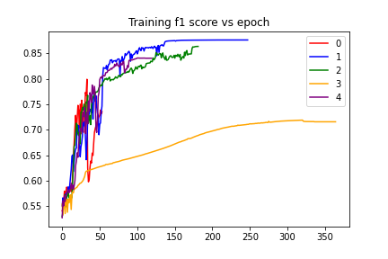
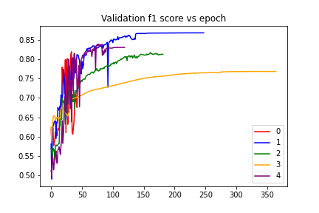
Training and validation F1 scores vs epochs

Slide 19
BrightKite link prediction
Fold Number | Valid ROC-AUC Score | Valid F1 Score | Test ROC-AUC Score | Test F1 Score
1 | 0.8898 | 0.8102 | 0.8863 | 0.8026
2 | 0.8846 | 0.8036 | 0.8785 | 0.7973
3 | 0.8943 | 0.8103 | 0.8922 | 0.8096
4 | 0.8816 | 0.8018 | 0.8855 | 0.8062
5 | 0.8971 | 0.8140 | 0.9014 | 0.8164
Cumulative | 0.8884 | 0.8079 | 0.8887 | 0.8052

Slide 20
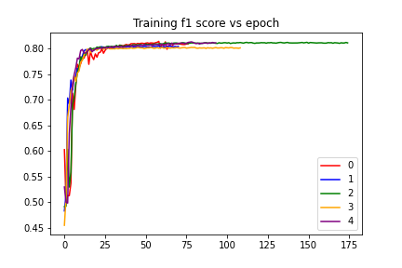
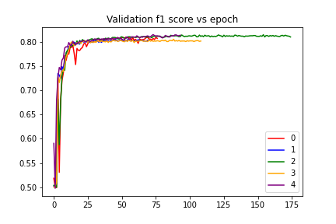
Training and validation F1 scores vs epochs

Slide 21
Side experiments done on BrightKite dataset
Keeping heads constant at 1 and number of layers fixed at 3.
Hidden Size | Test F1 | ROC
16 | 0.8039 | 0.8885
32 | 0.8049 | 0.8897
64 | 0.8052 | 0.8888
128 | 0.8084 | 0.8919

Slide 22
Side experiments done on BrightKite dataset
Now varying number of heads and keeping no of layers=3 and layer size fixed=16.
Number of Heads | Test F1 | ROC
1 | 0.8039 | 0.8885
2 | 0.8127 | 0.8968
4 | 0.8127 | 0.8975
8 | 0.8133 | 0.8956

Slide 23
Side experiments done on BrightKite dataset
Keeping number of heads constant at 1 and varying hidden layers keeping size fixed as 16.
Hidden Layers | Test F1 | ROC
1 | 0.670 | 0.6907
2 | 0.783 | 0.8609
3 | 0.8146 | 0.8975

Slide 24
Final results
We saw that we on using skip connections(idea from Resnet) and early stopping(a type of regularisation) along with the GAT layers, our model outperformed the other models on all tasks other than the link prediction task on BrightKite.
We are also using a learning rate scheduler which decreases the learning the learning rate by a factor of 10 if the validation error does not significantly improve for the last 10 epochs.
The fact that GAT’s gives different weights to neighbours based on their similarities during message propagation gives it more power than other GNN architectures like GCNs and GraphSage.

